Slide 1

ABC University | Quiz Application
Shaheed Abdillah | NCS Capstone Project

Slide 2





Technologies Stack
Technologies Used:
Java
Spring
Thymeleaf
REST
MySQL
Bootstrap

Slide 3
System Architecture
Database
Backend
Frontend

Slide 4
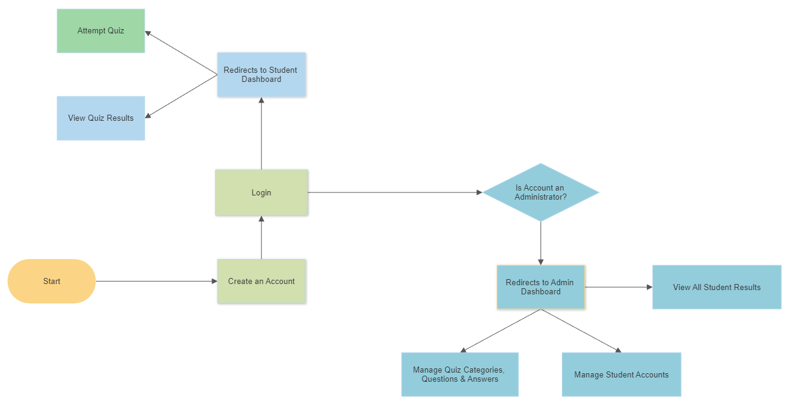
use case diagram
Student
Admin

Slide 5
SQL – Entity schema
4 Tables in Database ‘quiz’
Users – Who are the Users
Quiz – Quiz type (Based on difficulty level)
Questions – Questions generated by admin
Results – results based on the students answers

Slide 6
SQL – Users
Upon signup, SQL table will be updated based on the following inputs
Role will either be which is within SQL and not the sign up form:
Student
Admin
Id | Name | Password | Role | email
*Password is encrypted using BCryptPasswordEncoder (Spring Security)

Slide 7
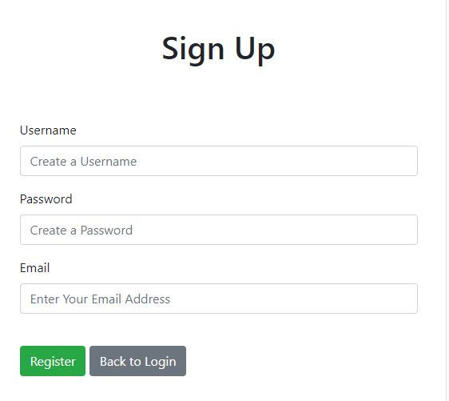
SQL – Users
Id | Name | Password | Role | email

Slide 8
SQL – Quiz
The categories can be anything
Difficulty to be set on 3 parameters:
Basic
Intermediate
Advanced
Id | Name | Category | Difficulty

Slide 9
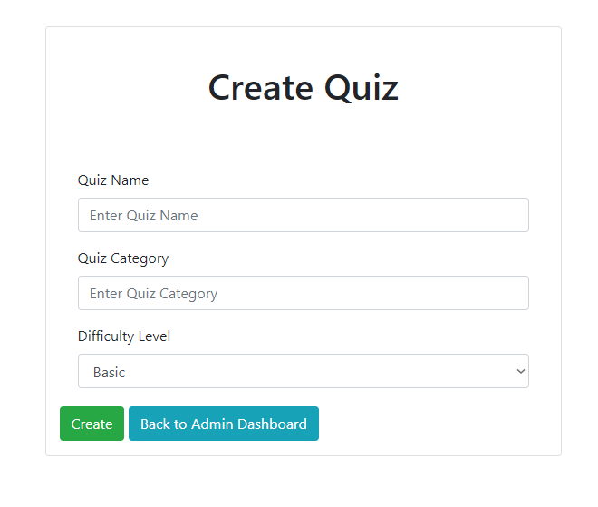
SQL – Quiz
Id | Name | Category | Difficulty

Slide 10
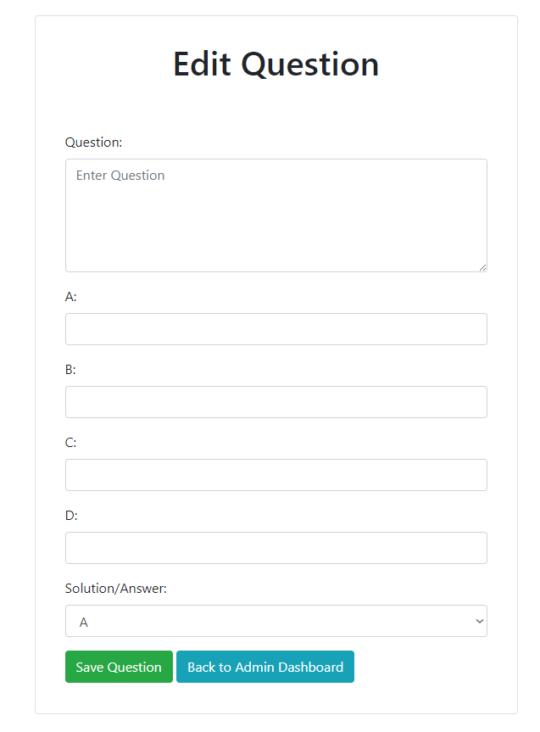
SQL – Questions
Id | Quiz Id | question | Option A | Option B | Option C | Option D | solution

Slide 11
SQL – Results
Student id is based on which student did the quiz
Quiz id shows the quiz the student did
Answer will be in the form of an array
Score shows the results
Id | Student id | Quiz id | Answer | Score

Slide 12
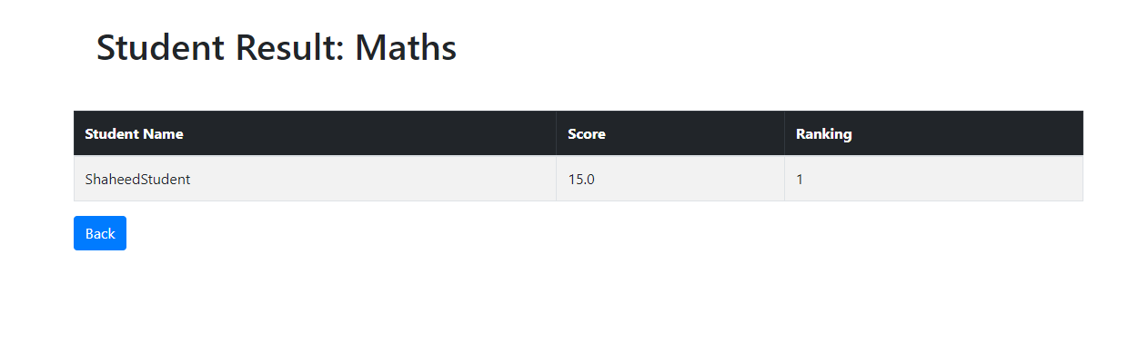
SQL – Results
Id | Student id | Quiz id | Answer | Score

Slide 13
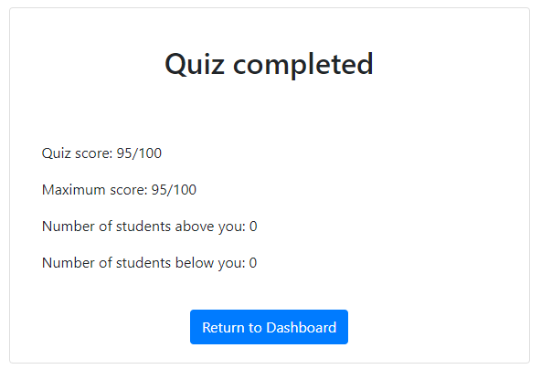
SQL – Results
Quiz score will be displayed here (5 points for each correct question)
Calculations of rankings based on the result table

Slide 14
Demo time

Slide 15

Thank You
shaheedabdillah@OUTLOOK.com

